Slide 1



The Governance Guide:
A best practice framework for allied health education and training
Notes:
The Governance Guide is a resource HETI has developed to provide an overarching framework and set of underpinning best practice principles to establish or enhance systems of governance for allied health education and training.

Slide 2

PRESENTATION OVERVIEW
Background
Governance and Education
Goals
Alignment with LHD/SN strategy
Framework Tour
What Next?

Slide 3

A GOVERNANCE GUIDE
WHY BOTHER?
  Across NSW Health there was an
  absence of guidelines or standards
  to provide a “road map” to support
  education and training for
  allied health professionals
Notes:
.

Slide 4

THE TRILOGY
Notes:
The Governance guide completes the trilogy of resources developed by the allied health portfolio of HETI to support allied health education and training in NSW Health.

Slide 5
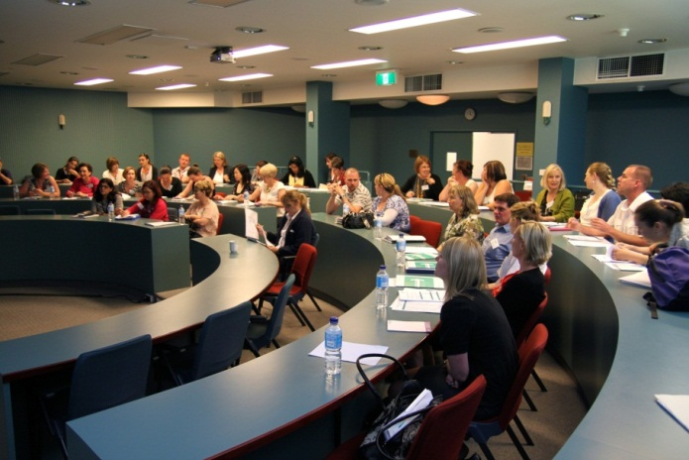
BACKGROUND
GOVERNANCE
“ Clinical Governance is the term used to describe a systematic approach to maintaining and improving the quality of patient care within a health system.”
“It is about the ability to produce effective change so that high quality care is achieved”
(New South Wales Ministry of Health, 2011)
Notes:
NSW Health defines
“clinical governance as the term used to describe a systematic approach to maintaining and improving the quality of patient care within a health system”
At the heart of good governance is the link between what you do, why you do it and the quality of patient care that is being achieved.

Slide 6
What is it ?
GOVERNANCE
A systematic approach to maintaining and improving the quality of education and training for allied health professionals across NSW Health
Notes:
The term governance in the context of this document formally refers to a systematic approach to maintaining and improving the quality of education and training for allied health professionals across NSW Health.

Slide 7
GOVERNANCE
What does it really mean?
Notes:
But what does it really mean?

Slide 8

GOVERNANCE
Governance is …..
The rules and processes that help allied health
ensure education and training
actually does and can happen in
the real world
Notes:
The rules and processes to make sure education and training actually does and can happen in the real world of allied health
In turn this will have a positive impact on our ability to provide high quality care to patients and improve health care outcomes – so these two things are directly related

Slide 9
THE GOALS OF THE FRAMEWORK
Short term
Consistent set of standards
Individuals, managers and organisations are aware of responsibilities
Medium term
Local systems of governance established
Long term
Education and training as core business for allied health professionals
Patients have access to a highly skilled workforce who deliver current up to date and evidence based health care

Slide 10

HOW DOES THIS RELATE TO US?
How does this relate to current work being conducted in this LHD/SN?
Will this help meet the NSW Ministry of Health service agreement for:
LHD/SN training and learning plan?
Support for AH education?
Notes:
This guide will assist to meet service agreements that include the need for
A LHD training and learning plan
Support for allied health education

Slide 11
THE GUIDELINES AND THREE STAKEHOLDER GROUPS
Individuals
Guidelines
System of Governance
Health Care Needs of the Population
Learning, Teaching and CPD
Clinical Supervision
Collaborative Relationships
Advocacy
Managers
Organisation
Notes:
The framework consists of 6 guidelines
Under each guideline there is a brief description followed by a set of indicators of achievement and practice examples attached to three specific stakeholder groups.
Individuals
Managers
Organisation
The individual section - outlines the expectations of individual allied health professionals to meet the specific guideline.
The manager section - outlines the expectations of managers/leaders to support achievement of the guideline.
The organisation section - outlines the expectations of the CE and Boards of the Local Health District or Specialty Network to support achievement of the guideline for allied health education

Slide 12
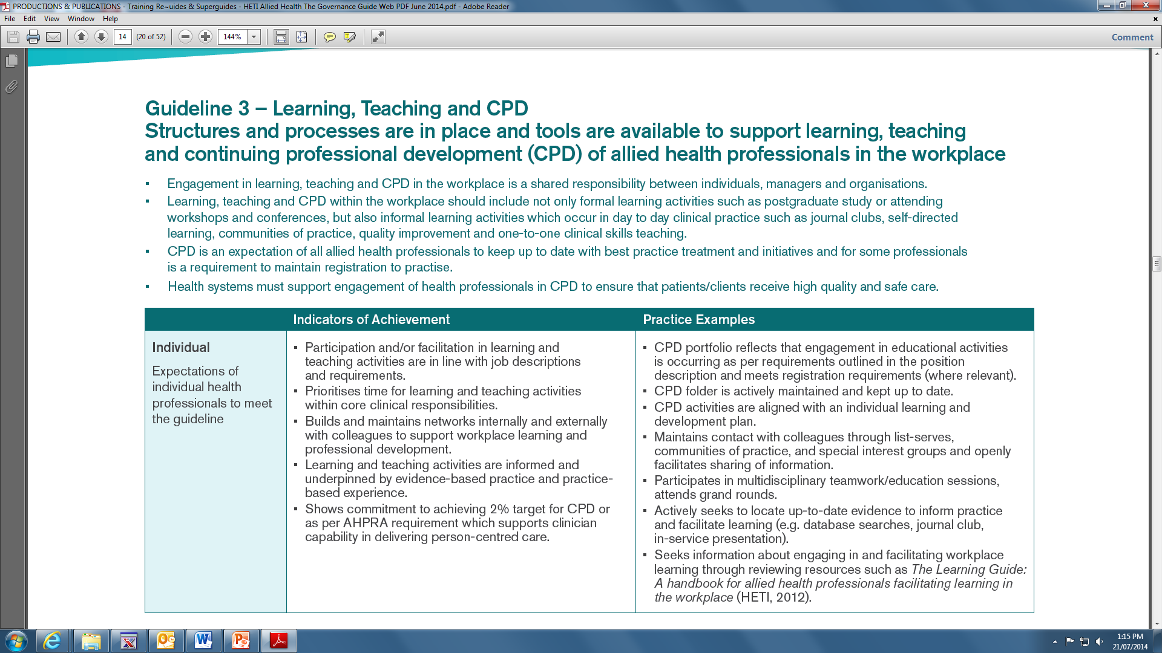
FRAMEWORK TOUR
Notes:
This is an example of the individual responsibilities.
At each of the three levels there are ‘Indicators of achievement” on the left and ‘practice examples’ on the right to illustrate how this would actually look in the real world.

Slide 13
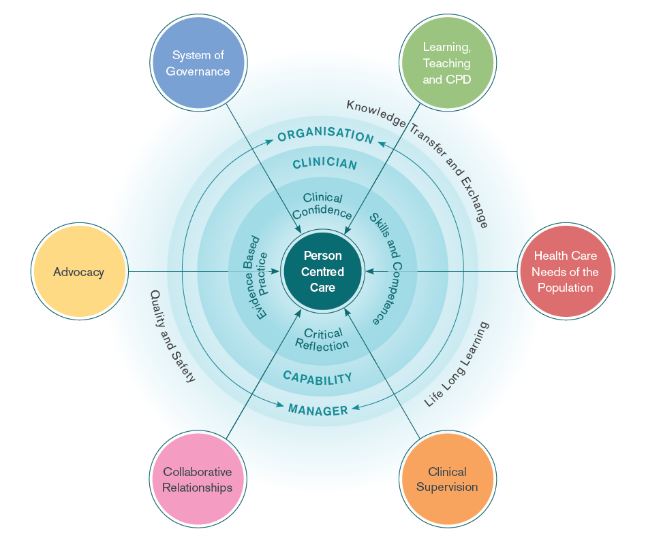

FRAMEWORK FOR ALLIED HEALTH EDUCATION & TRAINING
Notes:
So what does the framework actually look like-
It has six key areas which are illustrated in this model with each of these circles representing one of the guidelines contained in the framework.
You will note that in the middle is Person-centred care.
And the six areas of education governance all contribute to ensuring the allied health workforce has the skills and knowledge to provide person centred care in the context of also being a reflective practitioner, using evidence based clinical practice, and ensuring quality and safety.

Slide 14
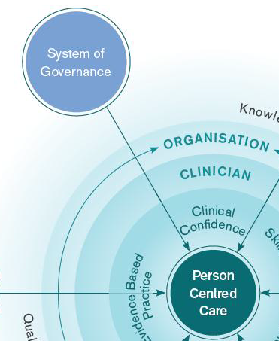
Guideline 1. System of Governance
FRAMEWORK TOUR
Description
Health services have a robust system of governance for education and training for allied health professionals
Practice Example
‘All position descriptions are up to date and clearly articulate educational responsibilities in line with industrial award requirements and level of experience’
Outcome
Education and training of allied health is core business of health services through the alignment of organisation and individual goals
Notes:
The following slides provide a snap shot of the 6 guidelines that make up this framework.
Each will include the overall goal and one practice example to give you an idea of what this might look like in practice.
Guideline 1 recommends that there is a governance system for allied health. A good place to start!
Practice examples around position descriptions and sustainable systems are included in this guideline.
The outcome of this guideline is that ‘Education and training of allied health is core business of health services through the alignment of organisation and individual goals’

Slide 15

Guideline 2. Health Care Needs of the Population
FRAMEWORK TOUR
Description
Planning of education and training for allied health professionals is driven by the health care needs of the population
Practice Example
‘Information gathered from patient/client groups and used to inform education activities, including demographics, case mix, disease profiles and satisfaction with care delivery’
Outcome
Patients/clients are treated by skilled professionals and teams with current knowledge and skills to meet their health care needs
Notes:
Guideline 2 ensures that the health care needs of the people we are working with, drive the education and training agenda for allied health.
This is the way it should be, but in practice is sometimes overlooked
Practice examples for this guideline demonstrate a clear connection between data, quality, standards and client needs
The outcome of this guideline is that ‘Patients/clients are treated by skilled professionals and teams with current knowledge and skills to meet their health care needs’.

Slide 16
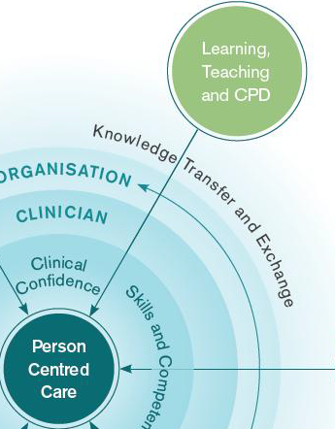
Guideline 3. Learning, Teaching and CPD
FRAMEWORK TOUR
Description
Structures and processes are in place and tools are available to support learning, teaching and continued professional development (CPD) of allied health professionals in the workplace
Practice Example
‘CPD activities are aligned with an individual learning and development plan’
‘ A minimum of 30 minutes per week is devoted to CPD (excluding mandatory training)’
Outcome
Systems to support learning and development are in place to ensure skill and competence of all allied health professionals
Notes:
Guideline 3 drills down into more of the logistics and practicalities of supporting education and training in the workplace.
What kind of activities does this mean?
How much CPD time is enough?
This practice example includes a tangible goal. This section also includes other practical examples like internet and library access.
The outcome of this guideline is that ‘Systems to support learning and development are in place to ensure skill and competence of all allied health professionals’

Slide 17
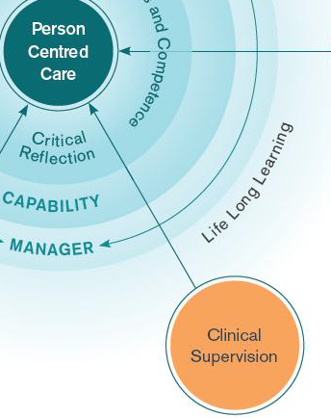
Guideline 4. Clinical Supervision
FRAMEWORK TOUR
Description
Allied health professionals have access to clinical supervision appropriate to their qualifications and level of experience
Practice Example
‘During a structured supervision session, supervisees bring an agenda, actions are recorded in a supervision log and CPD portfolios are utilised’
Outcome
Best practice in supervision is embedded within organisational structure and culture
Notes:
Guideline 4, highlights the importance of effective supervision and the need for training in this space.
The practice example for this guideline include structures and systems to formalise and support clinical supervision to support a competent allied health workforce.
The outcome of this guideline is that ‘Best practice in supervision is embedded within organisational structure and culture’.

Slide 18
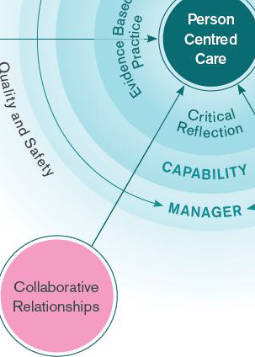
Guideline 5. Collaborative Relationships
FRAMEWORK TOUR
Description
Stakeholder relationships pertaining to allied health education and training are developed and fostered
Practice Example
‘Engages in committees, networks, research appropriate to their particular specialty or role’
Outcome
The quality and capacity for AHP and student education and training are enhanced through stakeholder collaboration
Notes:
Guideline 5 – acknowledges the importance of working in collaboration with both internal and external stakeholders to develop and foster AH education and training.
Practice examples in this guideline include partnering with a wide range of groups, from multidisciplinary to tertiary education providers and NSW Health organisations.
The outcome of this guideline is that ‘ The quality and capacity for AHP and student education and training are enhanced through stakeholder collaboration’.

Slide 19
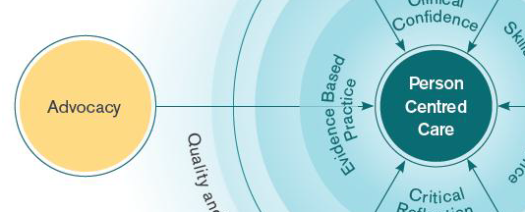
Guideline 6. Advocacy
FRAMEWORK TOUR
Practice Example
‘ Allied health professionals are
active members on committees within the organisation to influence priorities for education e.g. Quality committees, working groups, professional development committees’
Description
Allied health professionals are advocates for their education and training needs
Outcome
The organisation is responsive to the education needs of frontline staff to facilitate delivery of safe and high quality patient care
Notes:
Guideline 6 – Is about AH being equipped to advocate for their education and training needs.
The existence of this document is one way that this advocacy can occur.
Practice examples for this guideline include representation on committees, including education and training as standard items on agendas.
The outcome of this guideline is that ‘ the organisation is responsive to the education needs of frontline staff to facilitate delivery of safe and high quality patient care’.

Slide 20
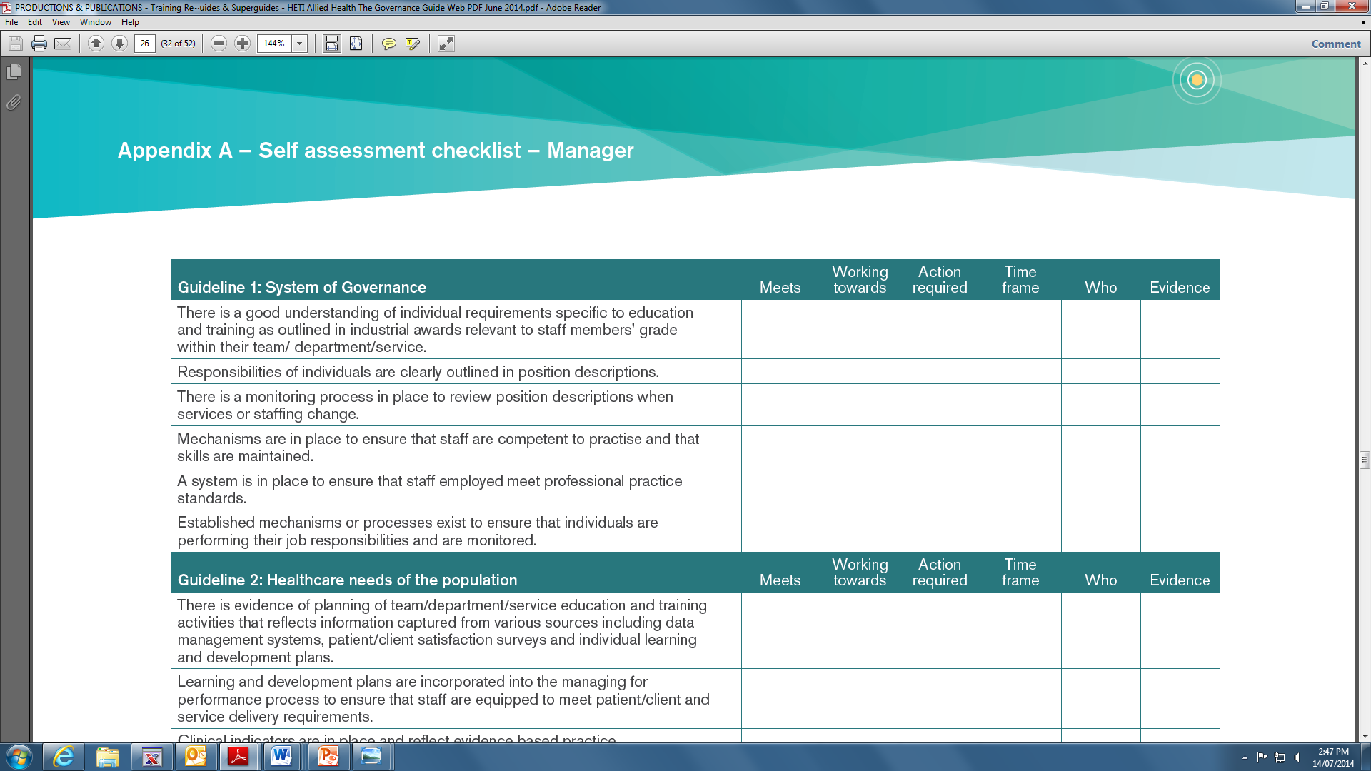
SELF ASSESSMENT CHECKLISTS
Notes:
Self assessment checklists have been developed to assist with the initial benchmarking against standards and development of action plans. These self assessment checklists are made up of ‘Indicators of achievement’ from each guideline .
These checklists are clustered under each of the three stakeholder groups – Individual, Manager and Organization.
This slide shows a section of the manager self assessment checklist.

Slide 21
Does this health service …
HOW DO WE MEASURE UP?
Have a robust system of governance for education and
  training for AHPs?
Plan education and training for AHPs based on the
  health care needs of the population and local service requirements?
Have structures and processes in place to support learning, teaching and CPD of AHPs in the workplace?
Provide AHPs with access to clinical supervision appropriate to their qualifications and level of experience?
Develop and foster stakeholder relationships pertaining to AH education and training?
Have AHPs who are advocates for their education and training needs?
Notes:
This all sounds good in theory but from your perspective….
Does your health service - have a robust system of governance for education and training for AHPs?
Does your health service – plan education and training for AHPs based on the health care needs of the population?
Does your health service – have structures and processes in place to support learning, teaching and CPD of AHPs in the workplace?
Does your health service – provide AHPs with access to clinical supervision appropriate to their qualifications and level of experience?
Does your health service – develop and foster stakeholder relationships pertaining to AH education and training?
Does your health service – Have AHPs who are advocates for their education and training needs?
These are good questions for all allied health to ask of their health service.

Slide 22

WHERE TO FROM HERE?
Establish foundations
Consultation
Self assessment
Identify priorities
Action plan
Implement
Plan for sustainability
Evaluate
Notes:
These are the stages in the recommended Implementation process for this guide.
Explore with the group the best place to start, using the decision tree in the Implementation tool kit.

Slide 23

QUESTIONS

